Slide 1

Scaling Your Startup
The Leading Global Business Law Firm
Presentation to Cyclotron Road
Jonathan Axelrad
jonathan.axelrad@dlapiper.com
July 21, 2016

Slide 2
Top Nine Startup Legal Issues
Formation
Intellectual Property
Issuing Equity
Hiring and Firing
Governance & Corporate Formalities
Securities Laws
Fundraising
Joint Venturing
Choosing Professional Help

Slide 3

1 – Formation: Taking the Plunge
Forming an entity:
Establishes credibility
Limits liability
Consolidate IP
Creates currency
Common Types of Entities:
C Corporation
Limited Liability Company (LLC)
Subchapter S Corporation

Slide 4
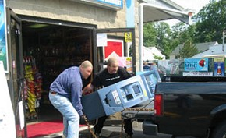
2 – Intellectual Property Protection
Make sure you own your Intellectual Property
Moonlighting responsibilities
Respect obligations to employer
Take steps to avoid conflict
Follow proper tech transfer procedures to obtain Intellectual Property from third parties
License process
IP developed after license agreement
Ongoing compliance with open source licenses

Slide 5
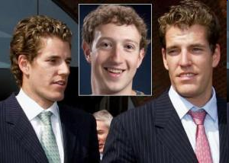

Intellectual Property Protection (cont.)
Consider filings to secure patent protection, trademarks, copyrights, URLs
Obtain rights from contributors
All work done for the company belongs to the company, including all IP
All company information to remain confidential
Require listing of prior inventions
University start-up
Dispute over IP ownership – no contracts, just a promise to pay him if venture succeeded
$65M settlement reached

Slide 6

3 – Issuing Equity
Stock = Control and Economic Interest
Allocate stock based on relative contribution (unequal split is okay)
Don’t assume that everyone will stay forever.
Corporate Governance
Who is on the Board of Directors? How are deadlocks resolved? who has the power to remove directors and officers?
Do you need a stockholder agreement?
Do you want employment contracts?
Vesting: Incentives to Stay and Deliver
The Company’s right to repurchase
Protections for Involuntary Termination
File the 83(b) election in 30 days!
Founder 1
Founder 2
Founder 3

Slide 7
Issuing Equity (cont.)
Equity Compensation
Options, warrants, restricted stock are important “currency” for start-ups low on cash, but . . .
Be mindful of your cap table; once a stockholder, a stockholder for life
Be aware of tax consequences
Generally, exercise price for options must be “fair market value” on date of grant; if not, can affect recipient AND the Company

Slide 8
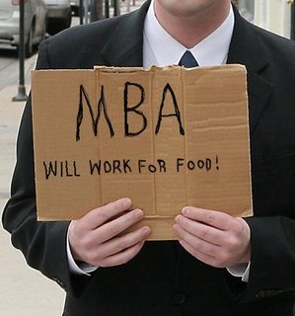
4 – Hiring & Firing
Hiring
“Employee” vs. “Independent Contractor”
IRS 20-factor test
“Exempt” vs. “Non-exempt”
Exempt: executive, professional, administrative and computer professional
Non-exempt: entitled to overtime
Outsourced HR Services: Trinet, ADP, Sequoia, & Finance Services
Invention Assignment Agreements & Specific Option Promises
Remember to buy back unvested shares
Don’t pay severance without a release of claims
Firing

Slide 9

5 – Governance & Corporate Formalities
Corporation is a separate person
To get limited liability, owners must honor the formalities
Piercing Corp. Veil (disregarding corp. entity)
Court will pierce veil when owner abuses corp. form
Operating corp. in purely individual capacity
Co-mingling of funds
Not holding board meetings or preparing meeting minutes
Undercapitalization

Slide 10

6 – Securities Laws
To prevent claims for rescission and complications for future financings and exits, comply with:
Federal securities laws
Exemptions from registration (confirm “accredited investor” status and no “bad actors”)
Disclose material information
State securities laws (“blue sky”)
Exemptions from qualification
Applies to ALL forms of “securities”
Stock, options, warrants, convertible debt, etc.

Slide 11
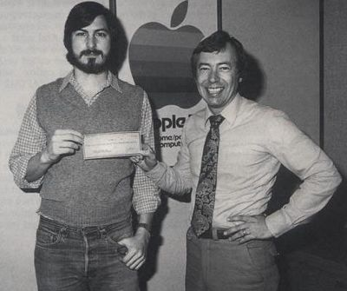
7 – Fundraising
Convertible Notes & Equity (SAFE)
Seed Funding
Friends & Family, Seed Funds, Family Offices & Corporate Strategists, Venture Capitalists

Slide 12

8 – Joint Venturing
Beware of non-market terms
Right of First Refusal or First Offer
Board vs. Board Observer Rights
Valuation
Joint Development of IP & Ownership

Slide 13
9 – Seeking Professional Help
Pick a Law Firm….or really DLA Piper (US) LLP
Global Platform Providing World Class Service to Emerging Growth Companies
DLA started as Ware and Freidenrich, one of the original Silicon Valley firms in the 60’s; worldwide footprint of 30+ countries and 80+ cities
Consistently ranked as a top emerging growth firm by PitchBook
78 Offices in 32 Countries– 4,500+ Lawyers
Energy and expertise to help startups grow
Venture Pipeline Program
Dedicated team of business professionals experienced in technology, start-ups and venture capital markets
Structured way to help entrepreneurs raise capital
Trusted source of deal flow for venture firms
Value-added service – no fees for company or investor

Slide 14



Seeking Professional Help (cont.)
We understand energy & resource innovation
We’ve built a cleantech ecosystem
Enerski
Powerhouse
Vote Solar
Relationships with family offices, venture capitalists, and corporate strategists
Preferred terms for cyclotron companies, including deferred fees & advisors

Slide 15
DLA Piper Resources
Jonathan Axelrad
(415) 836-2560
jonathan.axelrad@dlapiper.com

